Slide 1
SATELLITE IMAGE CLASSIFICATION
AJEY MUSUWATHI RAJKUMAR - 1220003616
VIVIEK NAGARAJAN - 1219798034
ARCHITTA BASKAR - 1219973144

Slide 2
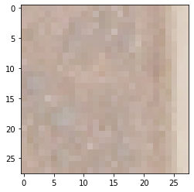
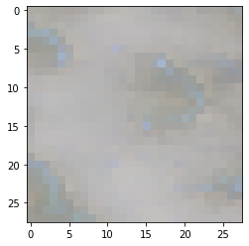
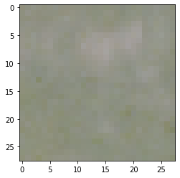
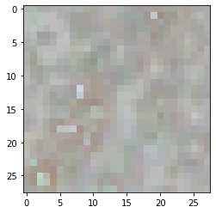
STATEMENT OF PROBLEM
Label 1 – Barren Land
Label 2– Forest
Satellite Images have a lot of use cases for environmental as well as for commercial purposes.
We are using the Satellite images from the Sat4 satellite to classify large land areas into 4 different labels as
Barren Land
Forest
Grass Land
Other Land types
We are classifying the land areas for zoning which will help in planning agricultural and rural development.
Label 3 – Grass Land
Label 4 – Other Land types

Slide 3
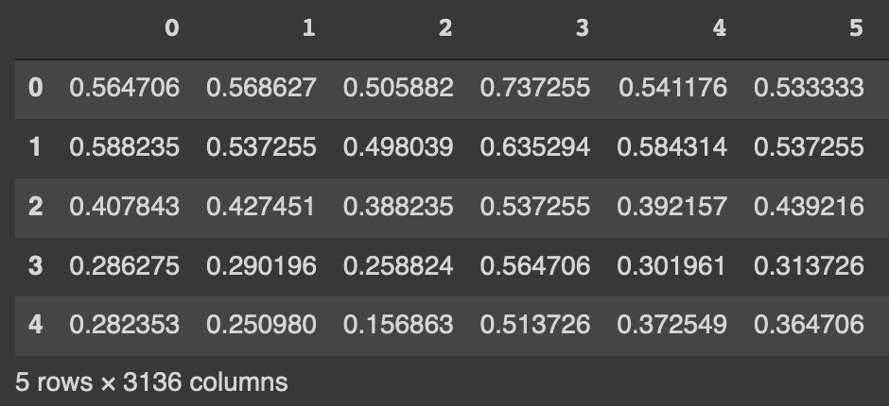
PROBLEM FRAMEWORK
SOURCE :
The Dataset was made available by the National Agriculture Imagery Program (NAIP) using SAT-4 airborne datasets. The dataset is composed of 28*28 pixels with 4 channels (Red, Green, Blue and Infrared).
Link: https://csc.lsu.edu/~saikat/deepsat/
DIMENSIONS :
We are using the training set composed of 400000 images coded into a csv file with 3136 feature columns.
We have split the data set and used 20% for validation and evaluation of our model.
Training data frame after complete preprocessing

Slide 4
MODEL EXPLANATION
We have used Convolutional Neural Network for our imagery classification for following reasons
It follows a hierarchical model which works on building a network , like a funnel , and finally gives out a fully-connected layer where all the neurons are connected to each other and the output is processed.
Convolution acts as a feature extraction for images .

Slide 5
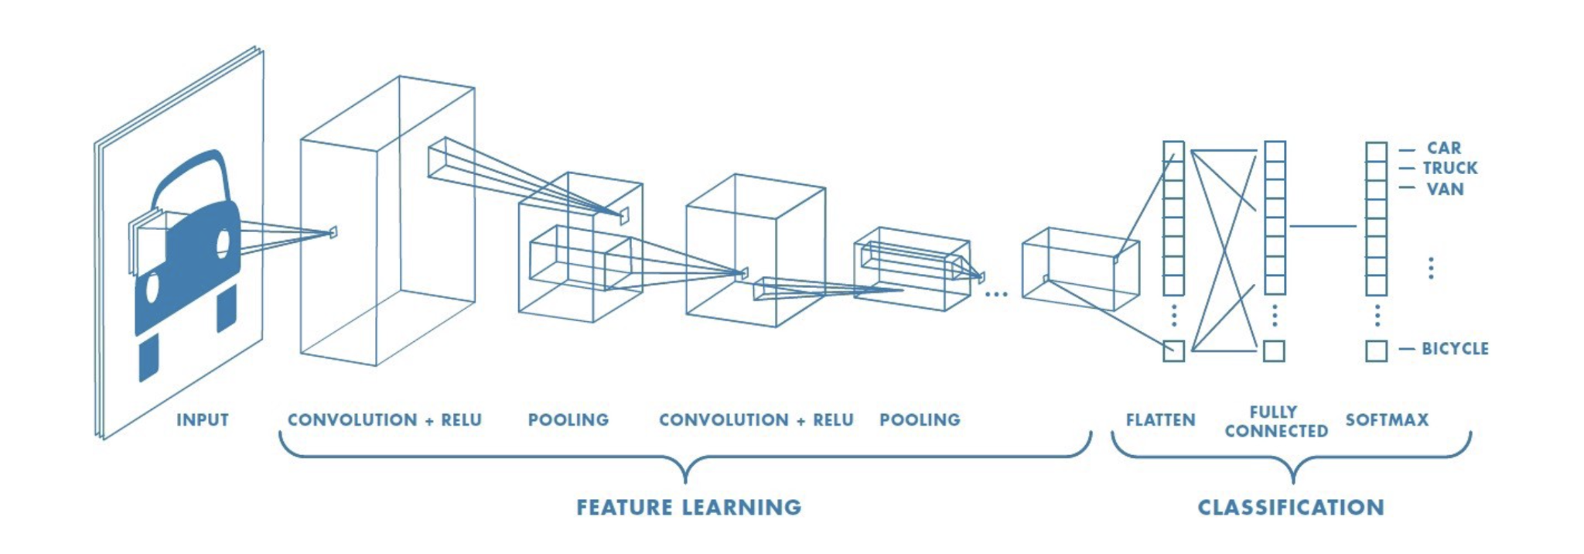
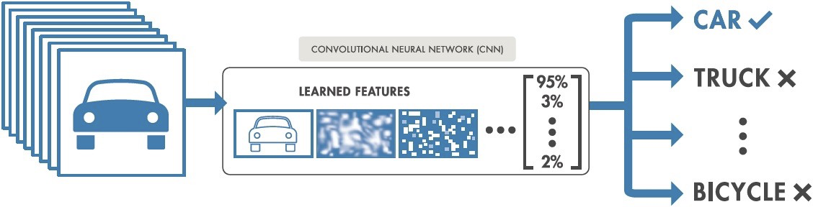
CNN FRAMEWORK:

Slide 6
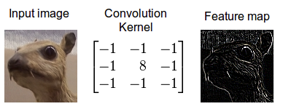
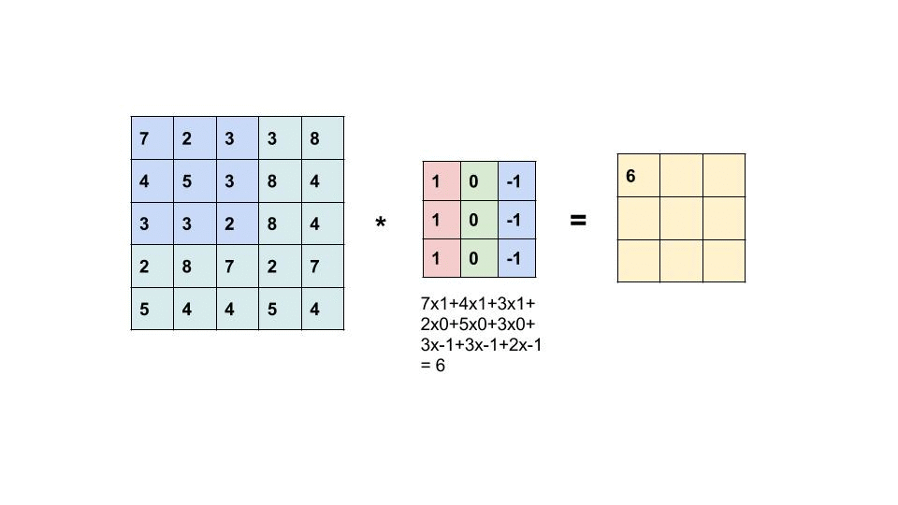
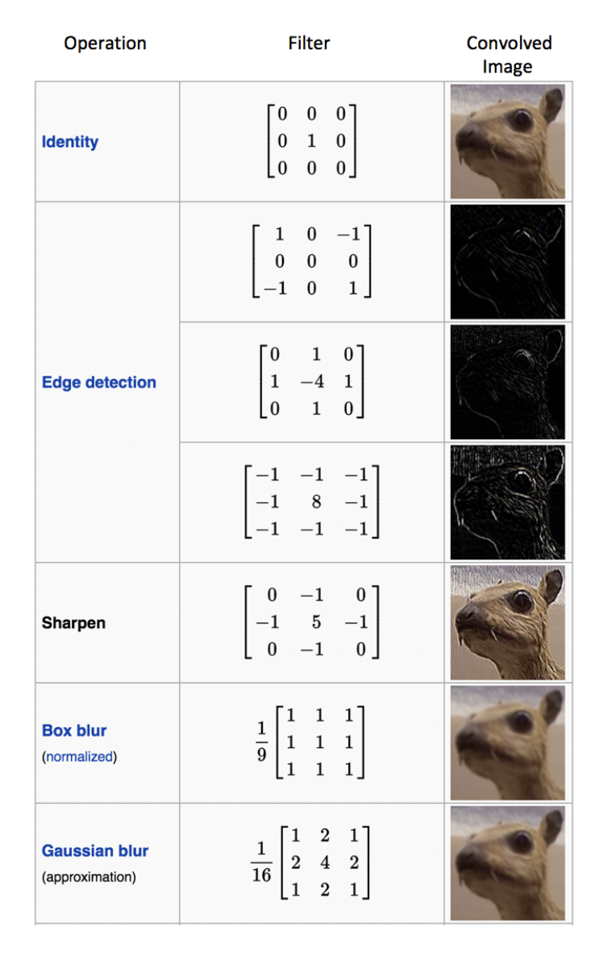

FEATURE EXTRACTION:

Slide 7
MODEL EXPLANATION
CNN ARCHITECTURE :
We have used an architecture which is a simplified version based on Alex Net and VGG 16 .
INSERT PICS OF ARCHITECTURE
We have used this architecture to avoid overfitting on our relatively smaller data when using ALEXNET or VGG 16

Slide 8


MODEL EXPLANATION
The rectified linear activation (RELU) function overcomes the vanishing gradient problem when used over many layers allowing modules to learn fast and perform better
RELU is the most popular activation layer when developing convolutional neural networks as it enables deeper model
For the output layer we are using a softmax activation function since our problem deals with a multiclass classification. The softmax function enforces the sum of the probabilities to be equal to one. So to increase the probability of one class the function forces the other classes to reduce giving an accurate decision when it comes to multiclass classification.

Slide 9
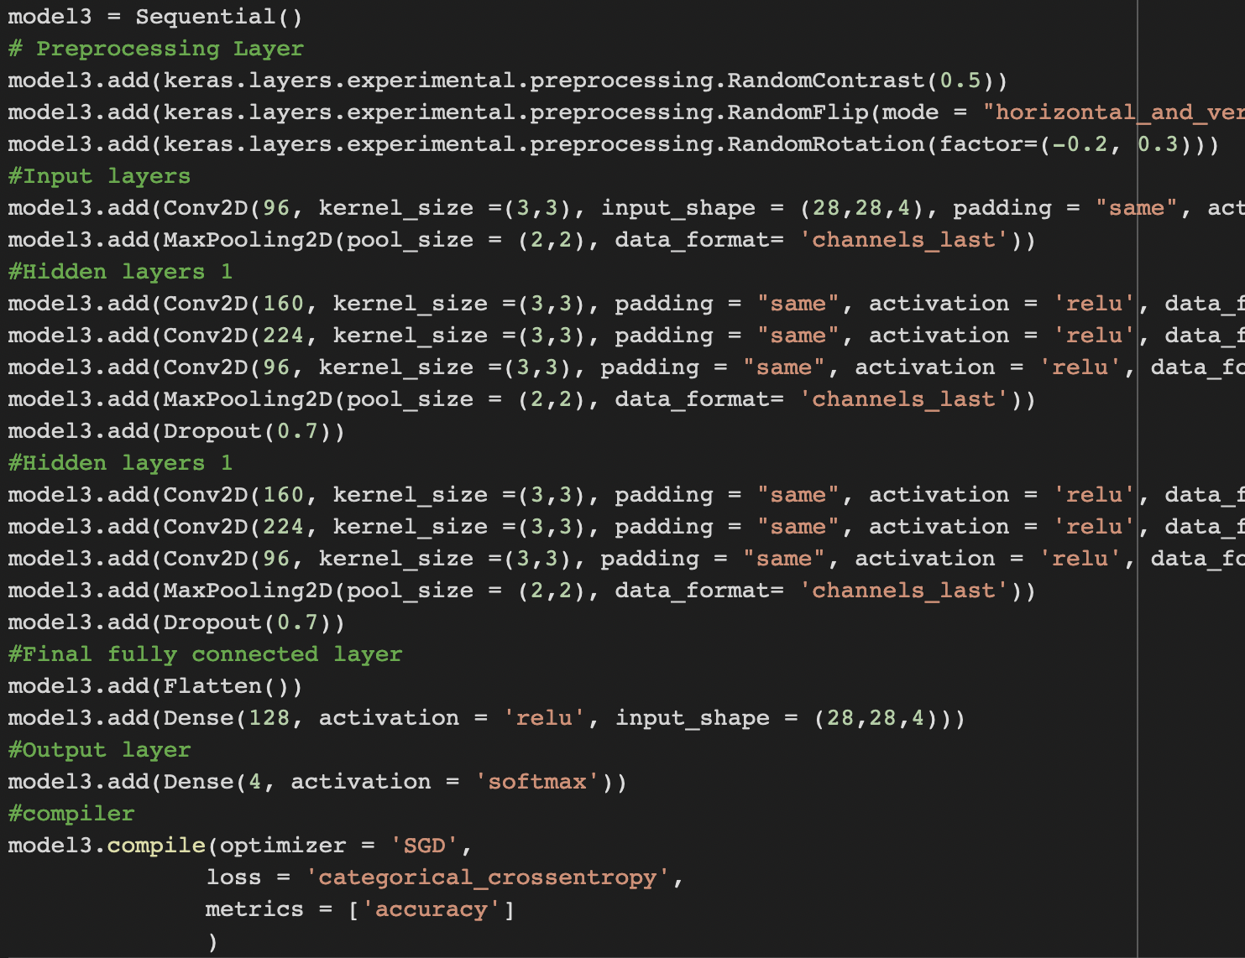
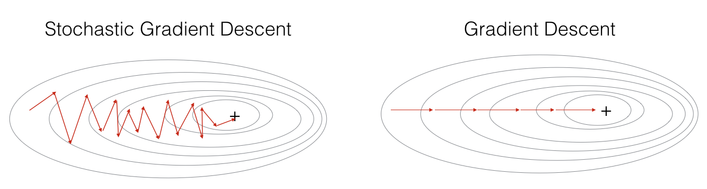
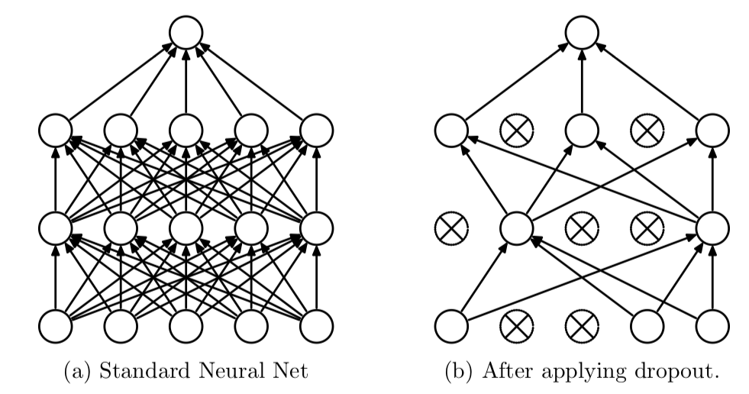
MODEL EXPLANATION
LOSS FUNCTION: We use Categorical cross entropy loss function for our multi-class classification as it is apt when there are two or more label classes as in our case.
OPTIMIZER: We use Stochastic Gradient Descent (SGD) over Adam since SGD only performs computations on a subset of the dataset (batches of data). This prevents redundancies and increases efficiency.
PENALIZATION: Dropout function was used as a penalization to prevent overfitting. It acts a Bayesian function decreasing weightage of certain layers by randomly deactivating neurons.
Optimizer
Dropout penalization

Slide 10
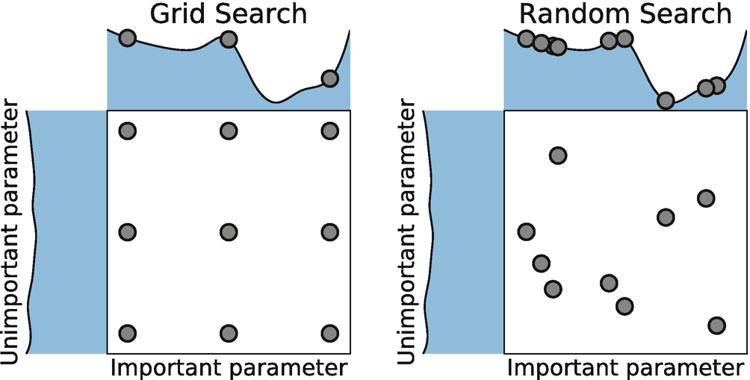
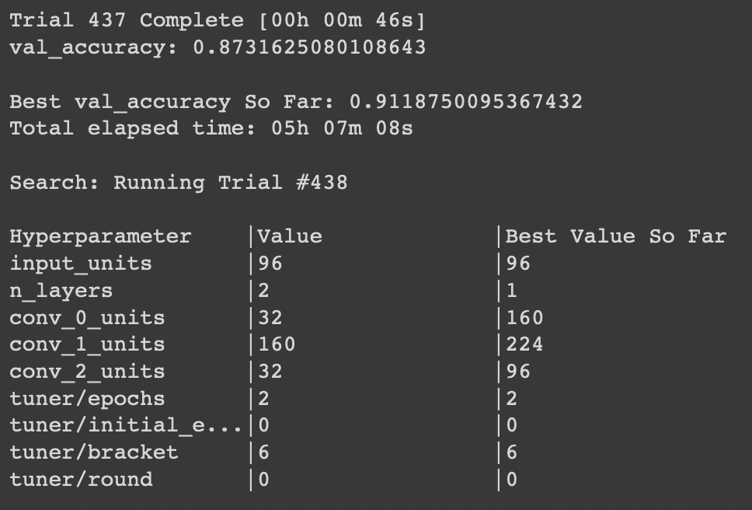
MODEL ANALYSIS
Tuning : We are using Hyperband to do random sampling by using time spent optimizing in the best way. Its a relatively new method for tuning iterative algorithms. It performs random sampling and attempts to gain an edge.
From the Hyperparameter tuning here is the best models with parameters
The Best fit model as a result of the tuning is as shown below with the loss and accuracy score for the training and testing set.

Slide 11
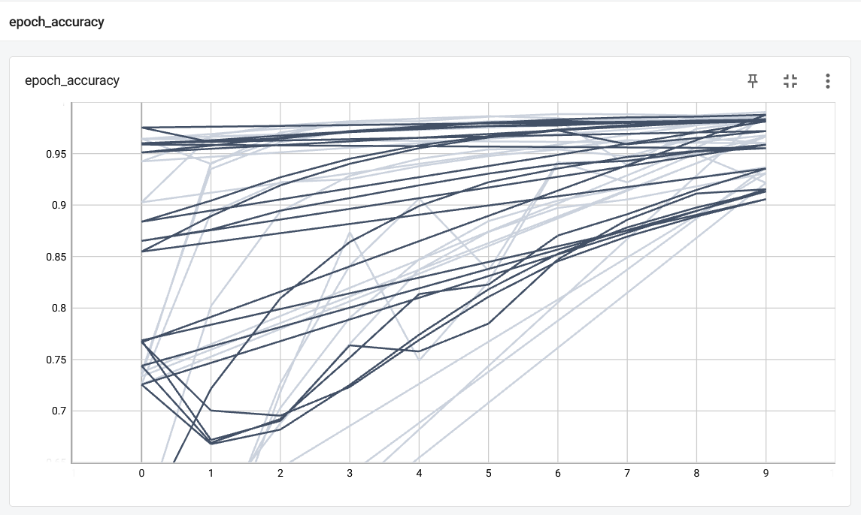
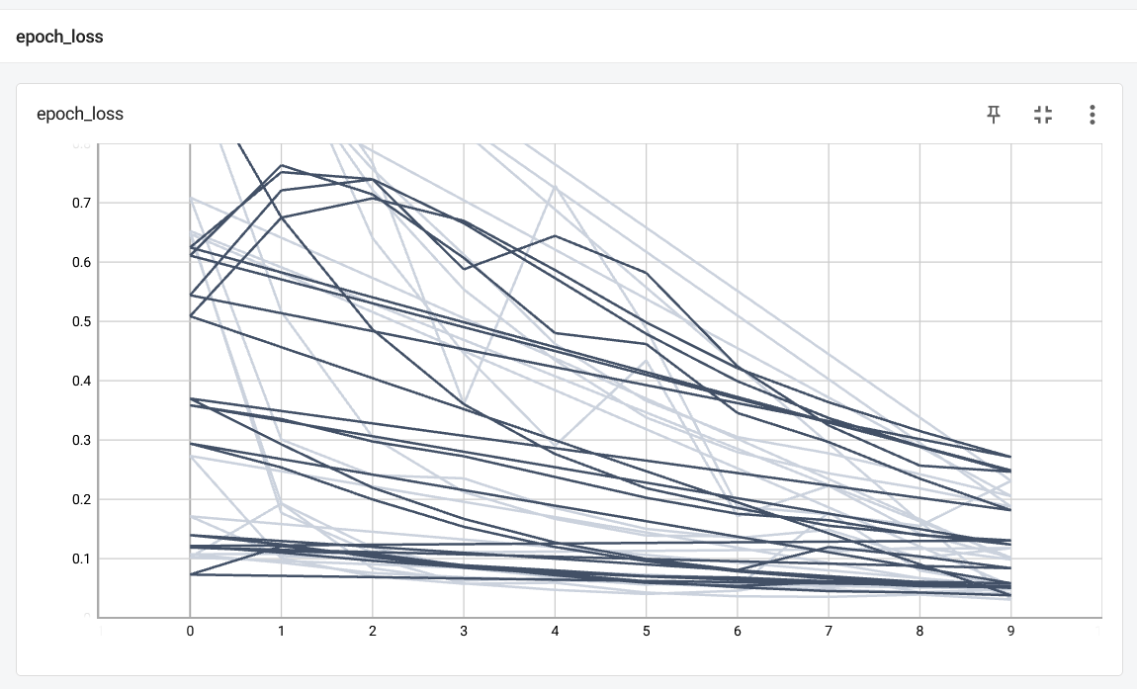
MODEL ANALYSIS
We are applying TensorBoard to visualize the Training and validation.
Here we have visualized loss and the accuracy scores for the best fit model at each epochs. We can observe that the accuracy score increases, and the loss value decreases as the epochs increases as the model trains.
Accuracy vs Training Epoch
Loss function vs Training Epoch

Slide 12
MODEL IMPROVEMENTS
We have currently explored only the AlexNet and VGG16 and were limited by our relatively small dataset, but with more sample data we could fit more complex architectures to improve model accuracy.

